Slide 1
Happiness Report
2015-2019

Slide 2
What is the Happiness Report?
First published in 2012 using the data from the gallup world poll, the world happiness report ranks 155 countries based on their happiness levels. The happiness scores and rankings are based off of answers to the main life evaluation questions asked in the poll. The report continues to gain global recognition as governments, organizations and civil society increasingly use happiness indicators to inform their policy-making decisions.

Slide 3
What makes up the Happiness Score?
Economy (GDP per capita)
Family
Freedom
Government
Generosity
Health (Life expectancy)

Slide 4
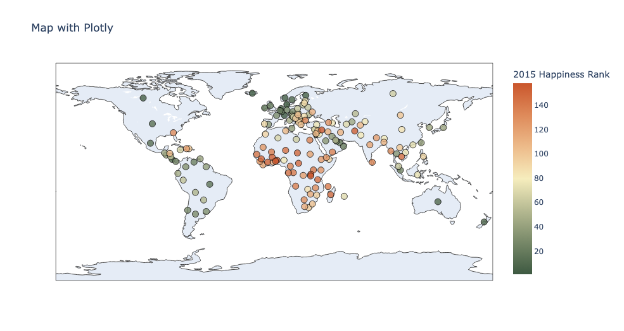
2015 Ranking Map

Slide 5
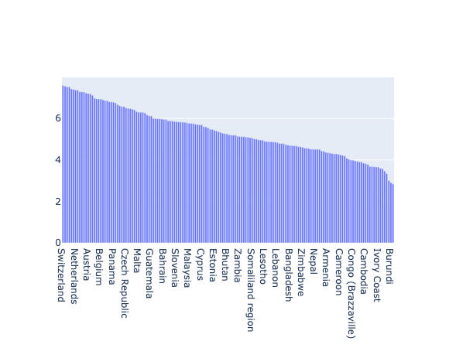
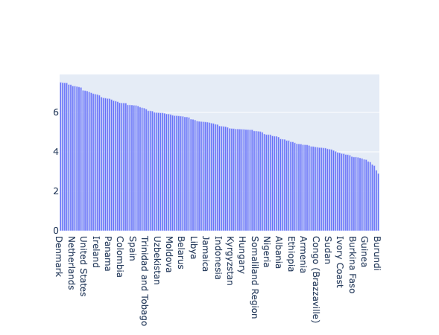
2015-2016 Happiness Rank
Notes:
Graphs or map

Slide 6
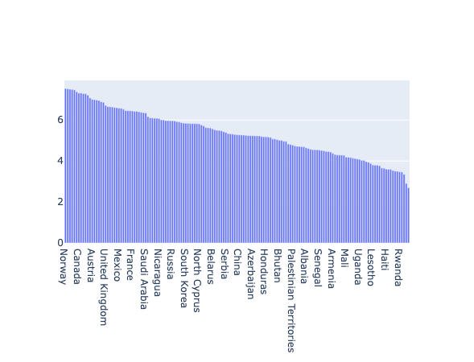
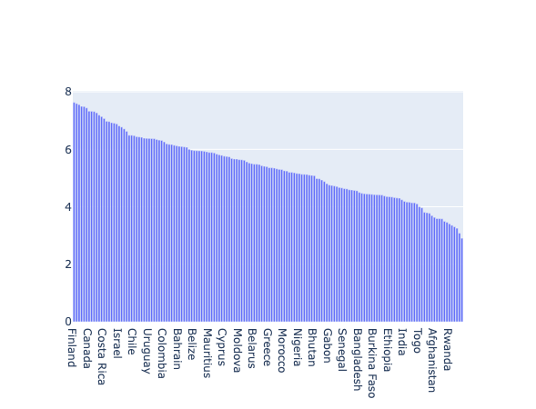
2017-2018 Happiness Rank
Notes:
Graphs or map

Slide 7
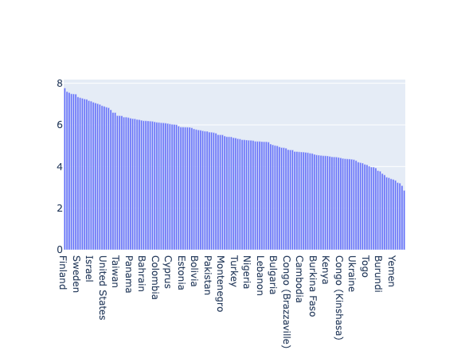
2019 Happiness Rank
Notes:
Graphs or map

Slide 8
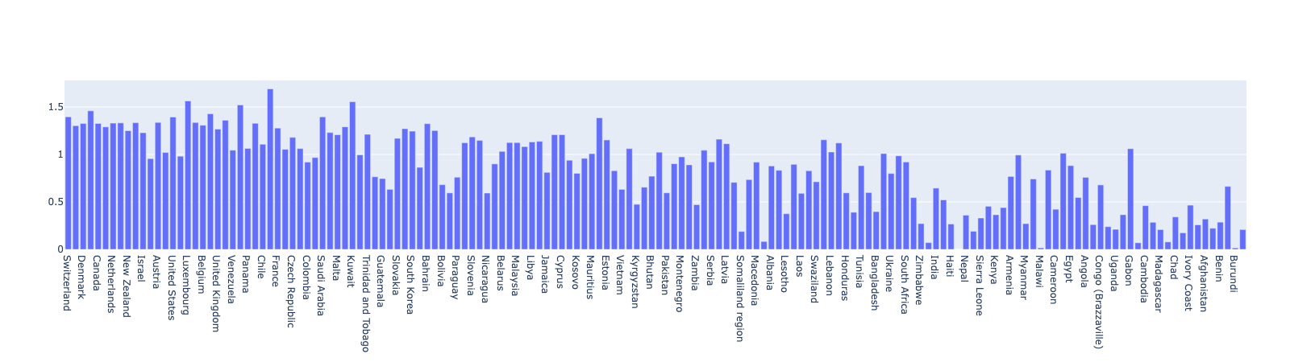
2015 Economy
Notes:
Graphs or map

Slide 9
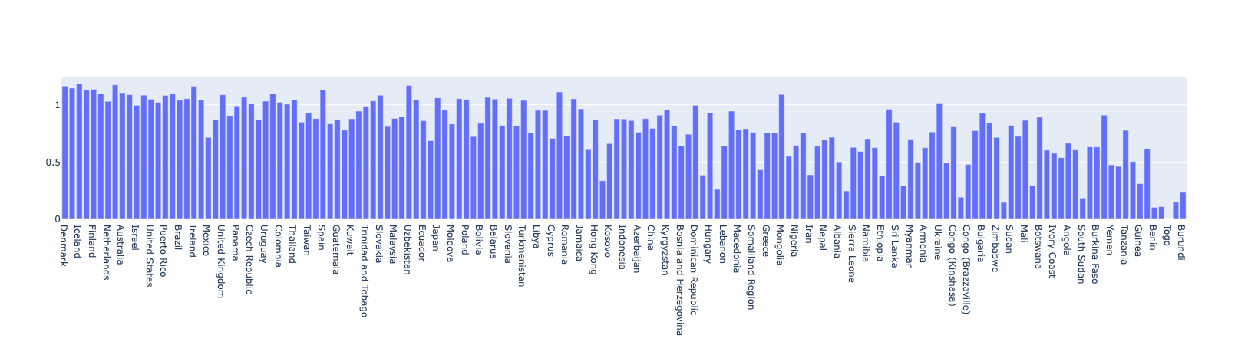
2016 Family
Notes:
Graphs or map

Slide 10
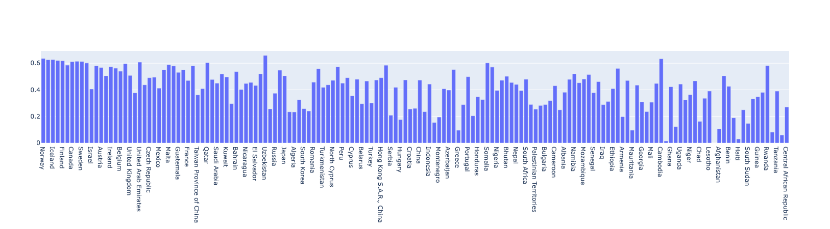
2017 Freedom

Slide 11
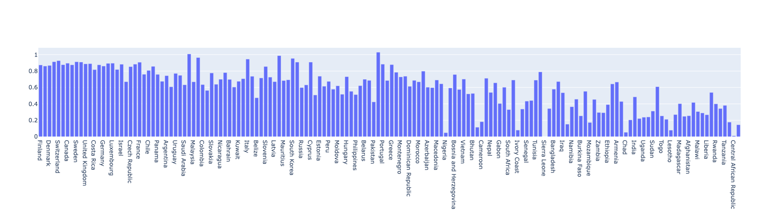
2018 Health (Life expectancy)

Slide 12
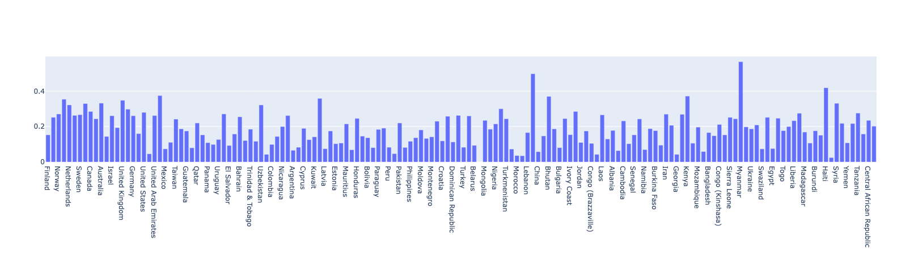
2019 Generosity

Slide 13
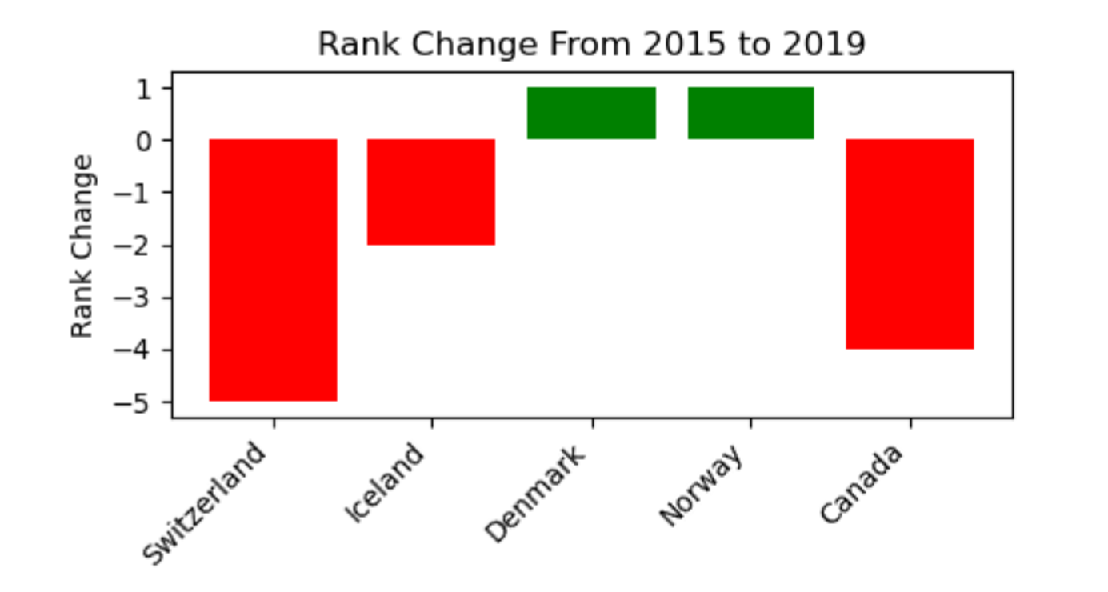
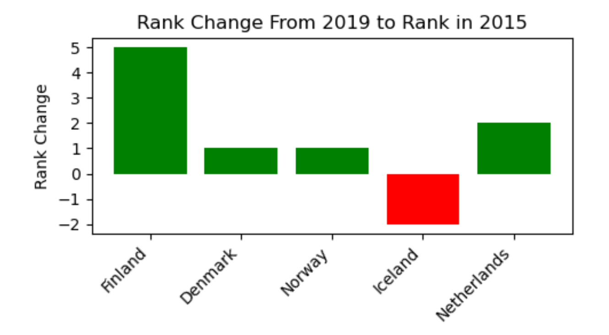
What changed throughout the years?
Did any of the top countries see a significant change?

